Slide 1
PROJECT HOPS
Charles Breedlove
Matthew Mackey
Aaron Holder

Slide 2
“How’s it goin’?”

Slide 3
“How’s it goin’?”
“Just livin’ the dream.”

Slide 4
Project Summary
Main Question: Where is the best place to open a new microbrewery?
Thesis: Our project is to look at geographic data combined with brewery data to determine the optimal place to open a new microbrewery

Slide 5
Why a Brewery?

Slide 6
BEER!

Slide 7
Why a Brewery?
“According to a 2009 article in the Wall Street Journal, 114 new microbreweries and brewpubs opened for business in 2008 despite the worldwide economic crisis. In many cases, people laid off from corporate jobs due to the recession took the opportunity to go into business for themselves by opening microbreweries.”
“Beer sales nationwide rose by 0.5 percent that year in the United States, but increased by 6 percent for craft beers. The craft beer and microbrewery business continued to expand despite the recession. The Brewers Association reported that 350 new breweries opened in the United States between 2011 and 2012 and the number of independent breweries reached its highest point since the year 1887. Sales of craft beer increased by 14 percent in the first half of 2012.”

Slide 8
Why a Brewery?
“By 2011 there were 2,000. This was the largest number of brewers in business at one time in the U.S. since the late 19th century -- and all but 50 of them were defined as craft beer brewers by the Brewers Association.”
“Overall U.S. beer volume sales were down 1% in 2017, whereas craft brewer sales continued to grow at a rate of 5% by volume, reaching 12.7% of the U.S. beer market by volume. Craft production grew the most for microbreweries.”

Slide 9
Why a Brewery?
“Even though microbrews and other craft beers can cost much more than mass-produced beers, many customers have been willing to pay the extra money for a better product. Having a pint of fine Belgian-style Tripel over dinner at a restaurant is a completely different drinking experience from popping the top on a can from the refrigerator, so the price of the two products cannot be realistically compared directly. A $5 to $7 pint is still much less expensive than many cocktails and wines, so customers don't necessarily perceive microbrews as an expensive product in context.”
“Retail dollar sales of craft increased 8%, up to $26.0 billion, and now account for more than 23% of the $111.4 billion U.S. beer market.”

Slide 10
But where? And for who?
Notes:
Transition to Matt here?

Slide 11
For Who
“65% of Americans now say they drink alcoholic beverages, choosing beer (43%) over spirits (32%) and wine (20%) ”
“Millennials account for 35% of beer consumption”
“The ‘craft’ movement now controls 12% of the beer industry, expected to reach sales of $45 billion by 2019 (18% growth)”
“Today’s consumers are responding eagerly – they love to support their local brewery, winery, and distillery. This consumer-led movement is most advanced within beer”

Slide 12
For Who
“Over 40% of Millennials are multicultural (Hispanic, African-American and Asian-American), with varied taste profiles and cultural identities. This makes them more exposed to different experiences, and more open to trying new things. When it comes to what they consume, they choose premium products and are more likely to equate price with quality. ”
“Millennials are also expected to push online sales in the coming years—53% plan to make an online purchase of alcohol– and because they’re digitally connected to their devices at all times, they offer brands additional avenues to reach them and generate pre-sale buzz.”

Slide 13
Where?
Notes:
This is what our project focused on…

Slide 14
Questions & Data
Questions asked of the data:
Population
Income Level
Age Breakdown
Competition

Slide 15
Questions & Data
Evaluated Data:
Geographic Data
Consumer Purchasing Data
Consumer Preferences Data
Census Data

Slide 16
Questions & Data
Data Sources:
Kaggle.com
Census.gov
Beer Advocate
Rate Beer
Untappd
Google Maps

Slide 17
Data Cleanup & Exploration
Kaggle: Limited data, only 4 breweries in MO an 1 in KS?
Untappd: Social media with review data; would take 2-3 weeks to get an API key
Beer Advocate: No API available
Rate Beer: Limited data

Slide 18
Data Cleanup & Exploration
Census: Learned about Metropolitan Areas
Google Maps: Used the APIs to find “brew” related data which would show us demand and competition

Slide 19
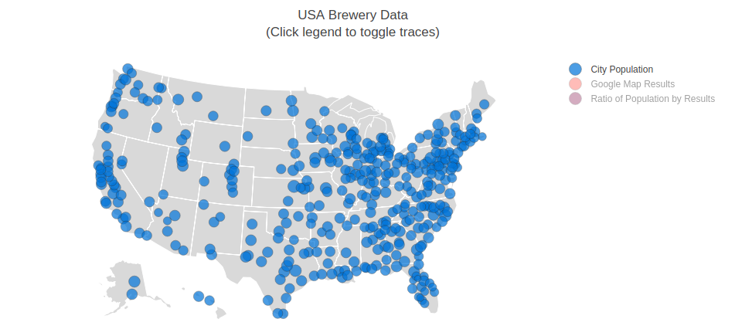
Data Analysis
Notes:
Finish off with Chuck? Add more slides for screen shots? Thought processes? Techniques.

Slide 20
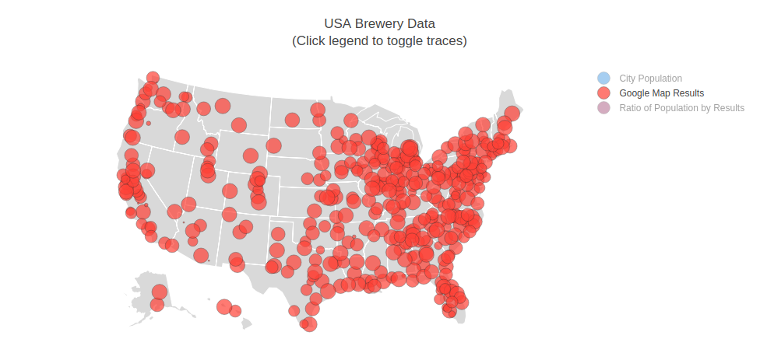
Data Analysis
Notes:
Finish off with Chuck? Add more slides for screen shots? Thought processes? Techniques.

Slide 21
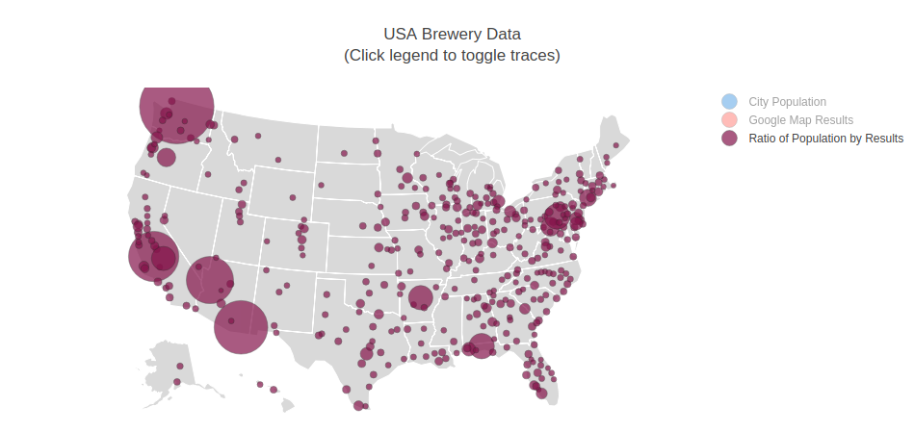
Data Analysis
Notes:
Finish off with Chuck? Add more slides for screen shots? Thought processes? Techniques.

Slide 22
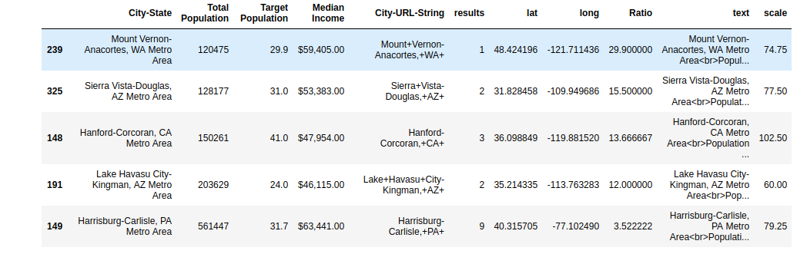
Data Analysis
Notes:
Finish off with Chuck? Add more slides for screen shots? Thought processes? Techniques.

Slide 23
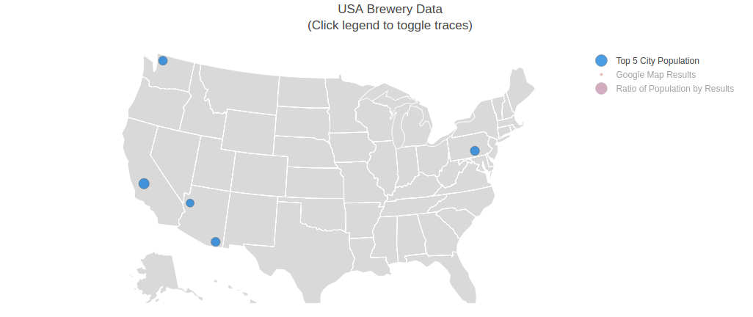
Data Analysis
Notes:
Finish off with Chuck? Add more slides for screen shots? Thought processes? Techniques.

Slide 24
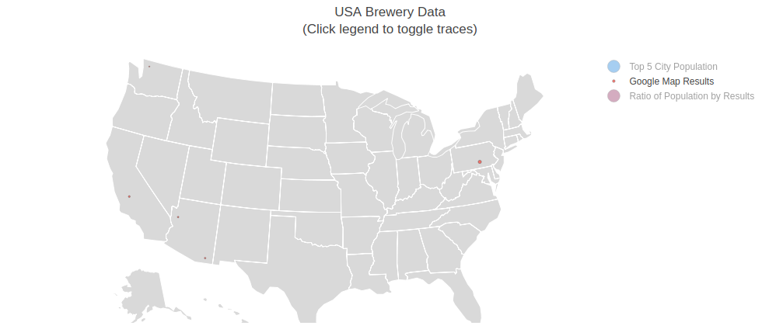
Data Analysis
Notes:
Finish off with Chuck? Add more slides for screen shots? Thought processes? Techniques.

Slide 25
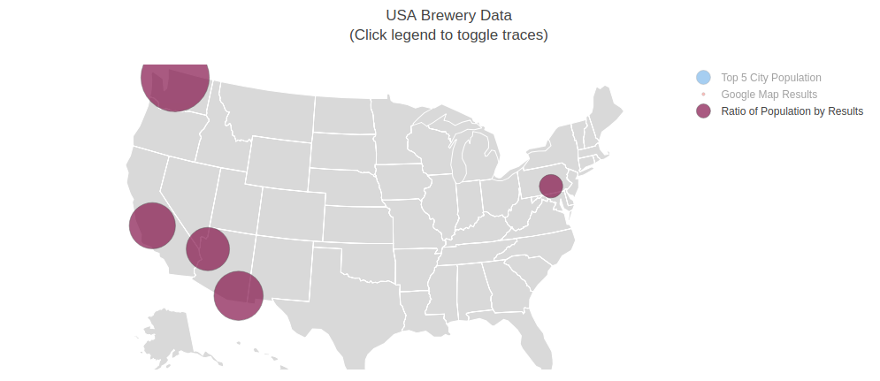
Data Analysis
Notes:
Finish off with Chuck? Add more slides for screen shots? Thought processes? Techniques.

Slide 26
Discussion

Slide 27
Post Mortem

Slide 28
QUESTIONS

